Slide 1
COMP 307 Demo
Asu Simla Ayduran 260822715
Christina Pilip 260887943
Luca Garnier-Landurie 260930881

Slide 2
The stack:
MERN stack
We are using the provided starter code

Slide 3
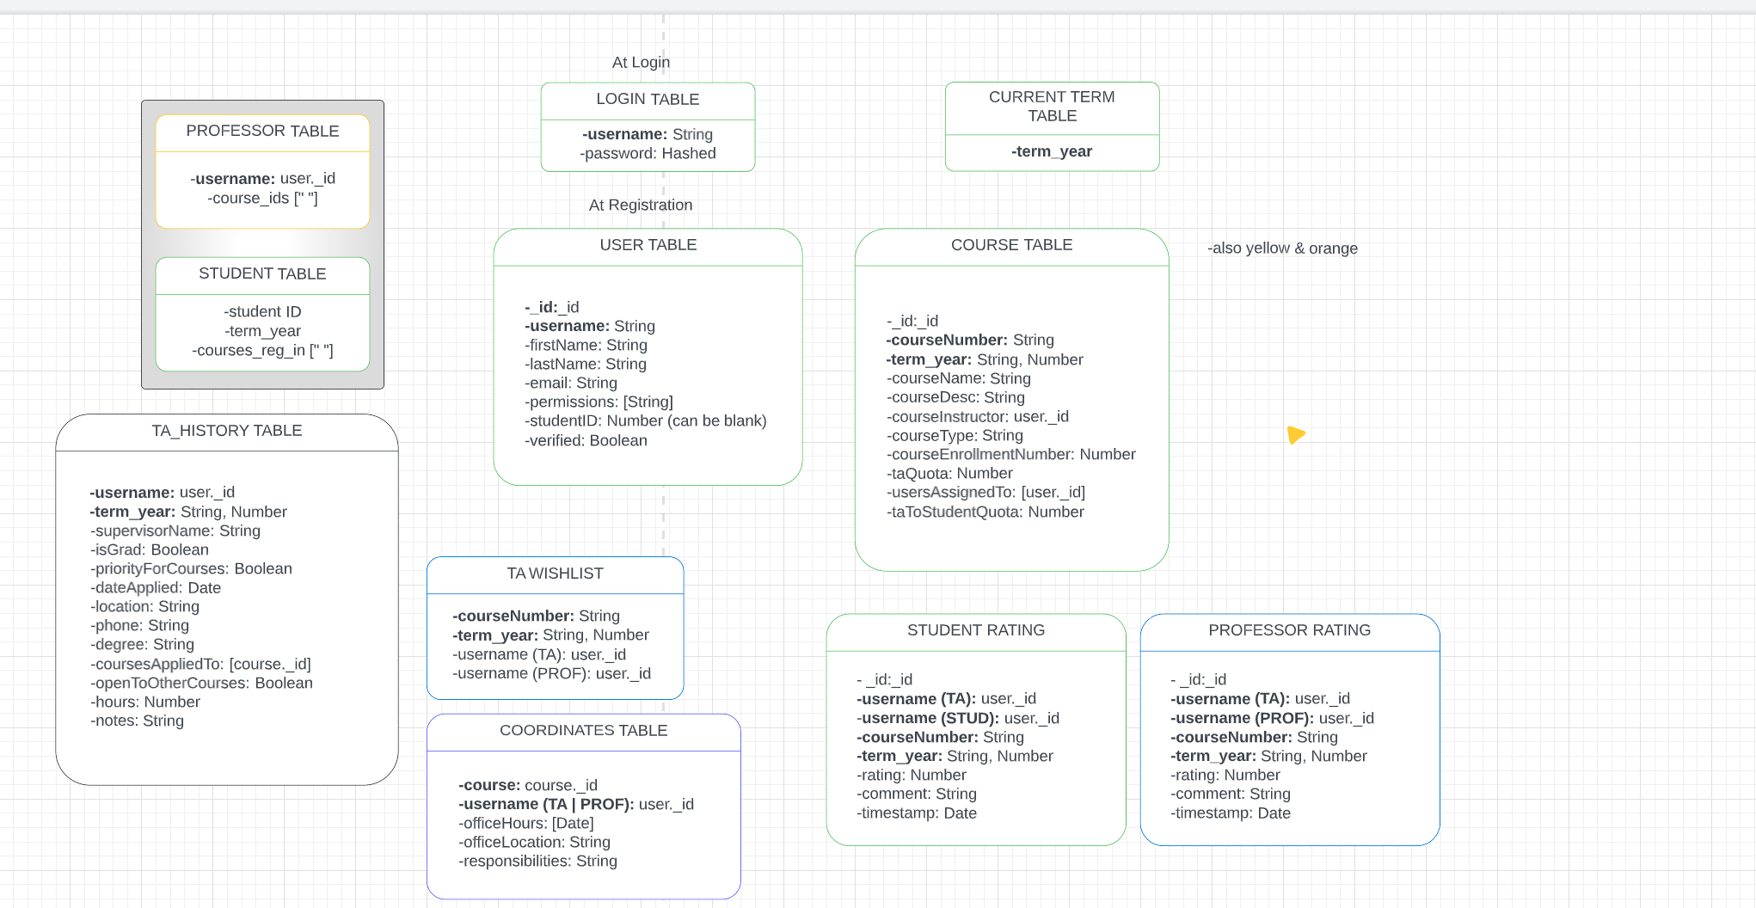

Slide 4
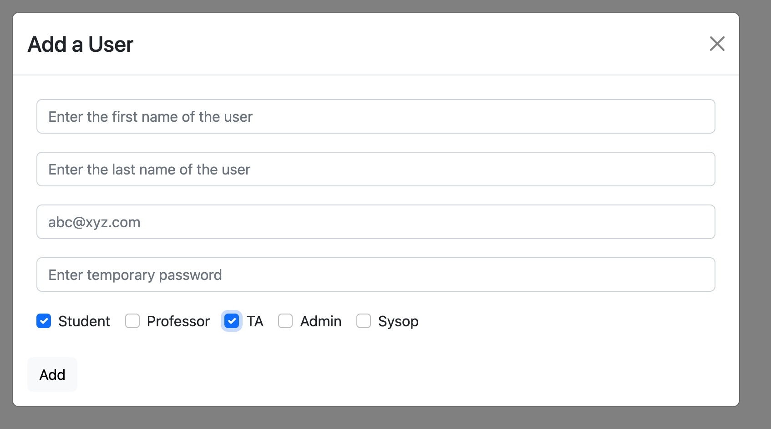
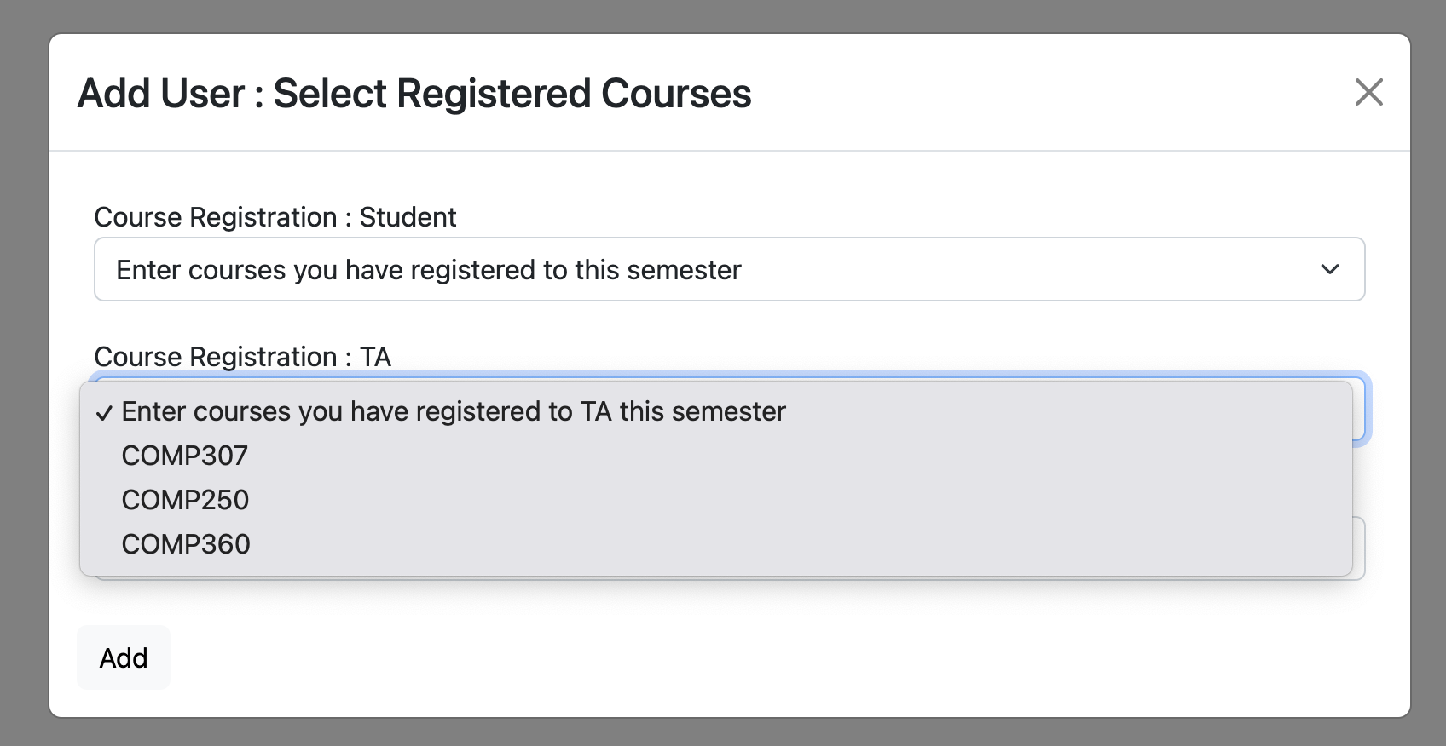
Registration

Slide 5
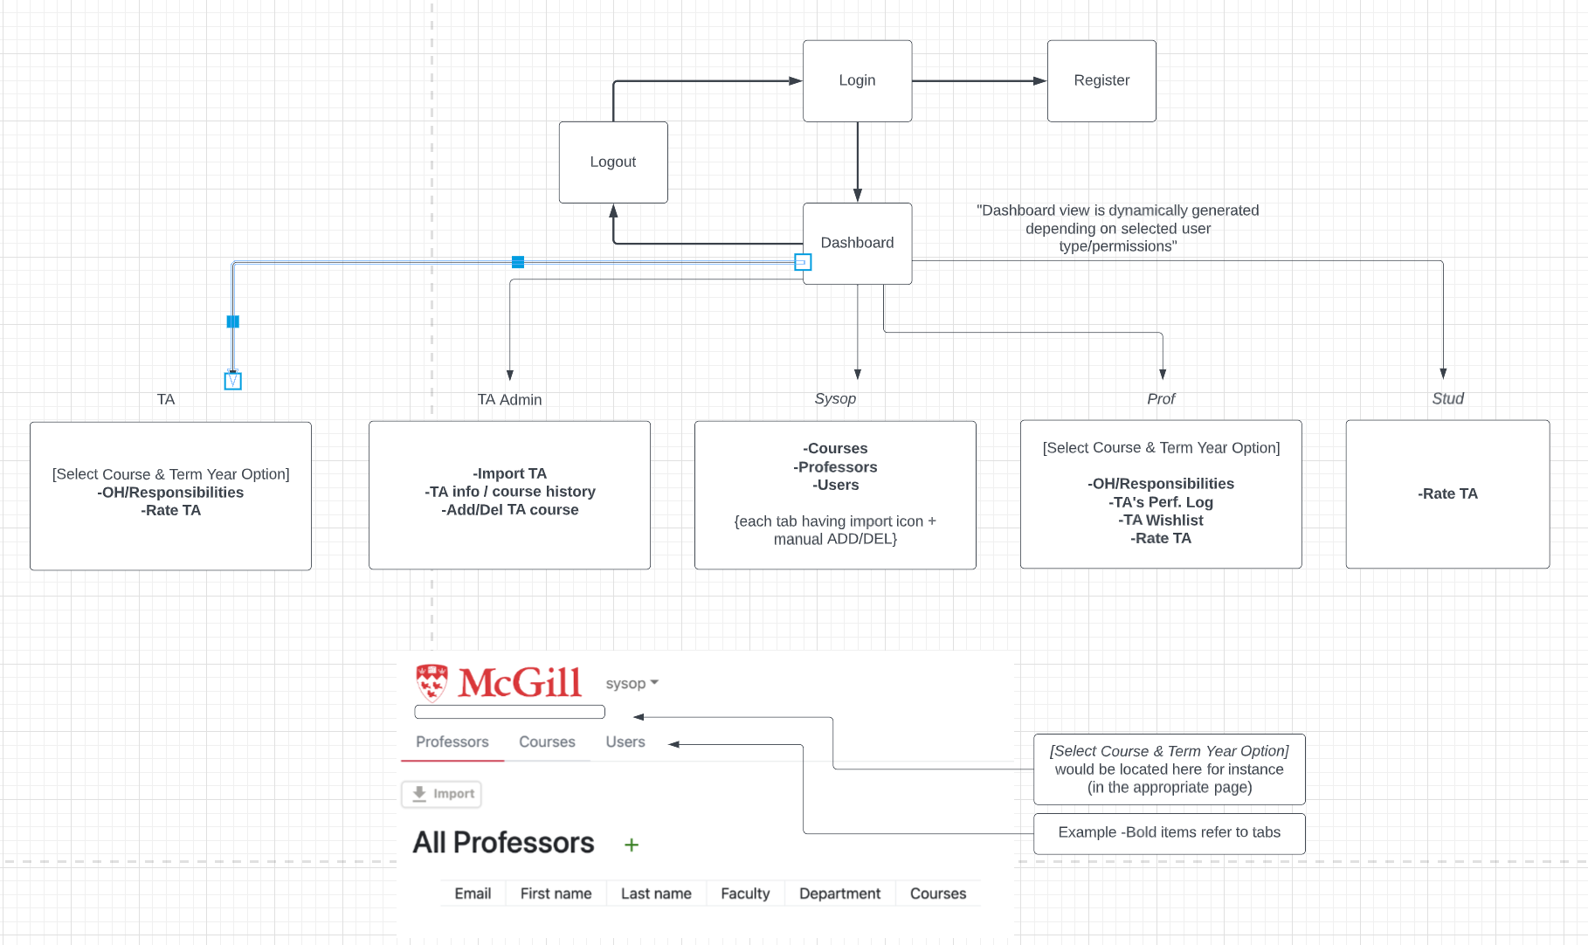
FlowChart

Slide 6
Pages that TA/Professor/Student can see (Plan)
Rate a TA
- Rate a TA form similar to AddCourseForm.tsx file and the user choose the course and the term from a drop down before Rating a TA in a text box.
2) All TAs In Course Report
Displays a report on the screen for all the TA's in the course.
Use a file/function to get the TA's average rating
Fetch performance log from prof ratings performance Database
- Fetch student rating comments from student ratings Database
Office Hours/Responsibilities (Select Course)
- Can be managed by a method that can add all TA information and display it through a ManagerTAInfo.tsx
4) Performance log/ Professor's Ratings (shows professor's entered ratings) (Select Course)
- Can be managed by a method that can add A Performance rating similar to a Student Review and display it through a ManagerTAlog.tsx file
5) Wishlist (professor selects TAs to wishlist) (Select Course) Assume that sysop has already added the courses for the next semester, so that the professor can pick.

Slide 7
Authentication and Permission Plan
- Allowing certain roles to Access certain tabs through tabsPerProfile and tabNamesToJSX constances in Dashboard.tsx
Storing Authentication in the Access token
We might use private routes to give permission

Slide 8
Sysop
Selecting the sysop view:
- Professors
Courses
Modified starter API to work with new database design
Added new functionality for updating course information
Users
Modified starter API to work with new database design
Added functionality for deleting users

Slide 9
Admin
Selecting the admin view:
- API for TAs tab, like the sysop views the Users
Import of TACohort.csv
Manually adding TA history entry
TA History tab (with options between selecting a TA or selecting a single course)
TA: can get all histories for a TA
Course: can get all TAs for a course
Add/Remove a TA to Course
Goes through course controller

